Slide 1
EE-357: CCN Mobile Radio Propagation: Large Scale Path Loss
Hassaan Khaliq Qureshi
School of Electrical Engineering & Computer Science
National University of Sciences & Technology (NUST)
Pakistan

Slide 2
Credits and Acknowledgements
Throughout this course, I will be borrowing examples, explanations and figures from the following books:
Rappaport, Wireless Communications, Prentice Hall, 2002.
Wireless Communications and Networks by William Stallings.
I will also be borrowing examples and figures from the online course material provided by Prof. Andrea Goldsmith, Stanford University
In this particular lecture, I will be borrowing concepts and figures from the Advanced Communication Systems Course by Dr. Syed Ali Khayam who taught this course 2 years back.
I am also borrowing figures from Mike Willis’s online tutorial: http://www.mike-willis.com/Tutorial/PF7.htm

Slide 3
Exam Question [different S and R]
A company owns two office towers in a city and wants to set up a 4-GHz microwave link between the two towers. The two towers have heights of 100m and 50 m, and are separated by 3 km. In the line of sight (LOS) and midway between the two towers is a third tower of height 70 meters. Will line-of-sight transmission be possible between the two towers? Justify your answer. Describe an engineering solution to obtain line-of-sight transmission
Notes:
Alpha and beta are same (similar triangle), therefore h can be calculated.

Slide 4
Diffraction: Losses
For an obstruction of height h, the Fresnel-Kirchhoff parameter is given by
The height h (and ν) is positive if the obstruction extends above the LoS and negative if it does not
h=0, ν=0
obstruction

Slide 5
Diffraction: Losses
For an obstruction of height h, the Fresnel-Kirchhoff parameter is given by
The height h (and ν) is positive if the obstruction extends above the LoS and negative if it does not
h negative
ν negative
obstruction

Slide 6
Diffraction: Losses
For an obstruction of height h, the Fresnel-Kirchhoff parameter is given by
The height h (and ν) is positive if the obstruction extends above the LoS and negative if it does not
h positive
ν positive
obstruction

Slide 7
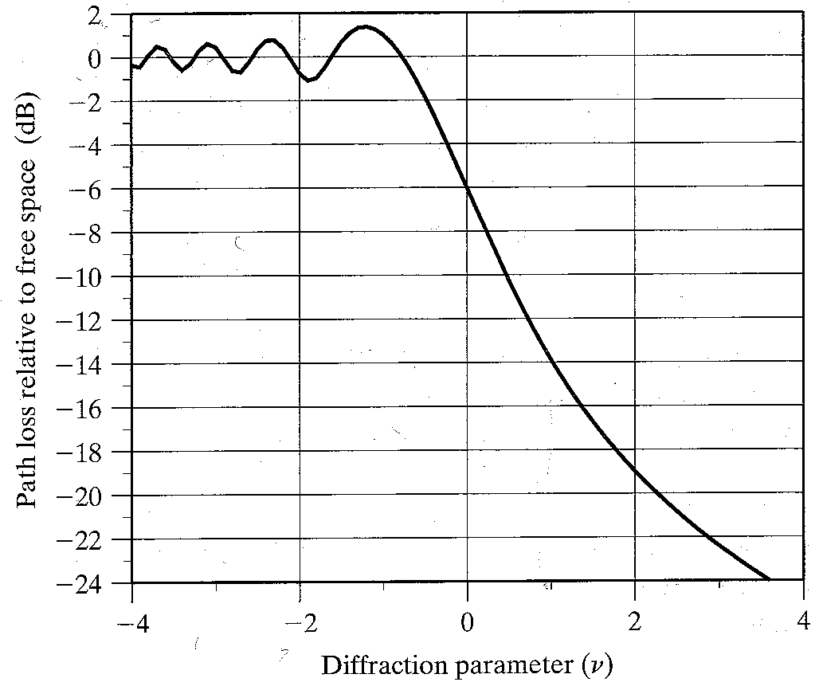
Diffraction: Losses on a Knife-Edge Obstruction
Figure 4.14 (rappaport)
Knife edge obstruction Gain (dB)
Notes:
The best value is zero in the figure since v is zero so h is also zero and we get a -6db gain and when v is negative then received energy or gain move around to zero.

Slide 8
Diffraction: Losses
Note that for fixed obstruction and transmitter, ν approaches infinity as d₁ or d₂ (distance of the obstruction) approaches zero
Thus the loss becomes infinitely large as the transmitter or receiver moves more and more into the shadow of the obstruction

Slide 9
Diffraction: Losses
The radius of the Fresnel zone circles is maximum when we are midway between transmitter and receiver and decreases if we move towards transmitter or receiver.
Consider the example of the first Fresnel zone circle at different locations.
Slide Credits :Mr Hassan Aqeel

Slide 10
Diffraction: Losses
The radius of the Fresnel zone circles is maximum when we are midway between transmitter and receiver and decreases if we move towards transmitter or receiver
Consider the example of the first Fresnel zone circle at different locations
Slide Credits :Mr Hassan Aqeel

Slide 11
Diffraction: Losses
The radius of the Fresnel zone circles is maximum when we are midway between transmitter and receiver and decreases if we move towards transmitter or receiver
Consider the example of the first Fresnel zone circle at different locations
Slide Credits :Mr Hassan Aqeel

Slide 12
Diffraction: Losses
The radius of the Fresnel zone circles is maximum when we are midway between transmitter and receiver and decreases if we move towards transmitter or receiver
Consider the example of the first Fresnel zone circle at different locations
Slide Credits :Mr Hassan Aqeel

Slide 13
Diffraction: Losses
The radius of the Fresnel zone circles is maximum when we are midway between transmitter and receiver and decreases if we move towards transmitter or receiver
Consider the example of the first Fresnel zone circle at different locations
Slide Credits :Mr Hassan Aqeel

Slide 14
Diffraction: Losses
The radius of the Fresnel zone circles is maximum when we are midway between transmitter and receiver and decreases if we move towards transmitter or receiver
Consider the example of the first Fresnel zone circle at different locations
Slide Credits :Mr Hassan Aqeel

Slide 15
Diffraction: Losses
The radius of the Fresnel zone circles is maximum when we are midway between transmitter and receiver and decreases if we move towards transmitter or receiver
Consider the example of the first Fresnel zone circle at different locations
Slide Credits :Mr Hassan Aqeel

Slide 16
Diffraction: Losses
The radius of the Fresnel zone circles is maximum when we are midway between transmitter and receiver and decreases if we move towards transmitter or receiver
Consider the example of the first Fresnel zone circle at different locations
Slide Credit: Hassan Aqeel

Slide 17
Exercise
Compute the diffraction loss for the three cases. Assume λ=0.33m, d₁=1 km, d₂=1 km, and
(a) h=25 m,
(b) h=0,
(c) h=-25m.
Find the Fresnel zone within which the tip of the obstruction lies.

Slide 18
Exercise
Compute the diffraction loss for the three cases shown below. Assume λ=0.33m, d₁=1 km, d₂=1 km, and
(a) h=25 m:
(b) h=0:
(c) h=-25m:

Slide 19
Exercise
Compute the diffraction loss for the three cases with the help of a graph. Assume λ=0.33m, d₁=1 km, d₂=1 km, and
(a) h=25 m=>ν=2.74 (b) h=0=>ν=0 (c) h=-25m=>ν=-2.74
Knife edge obstruction Gain (dB)

Slide 20
Exercise
Compute the diffraction loss for the three cases. Assume λ=0.33m, d₁=1 km, d₂=1 km, and
(a) h=25 m=>ν=2.74 (b) h=0=>ν=0 (c) h=-25m=>ν=-2.74
Find the Fresnel zone within which the tip of the obstruction lies.

Slide 21
Exercise
Compute the diffraction loss for the three cases. Assume λ=0.33m, d₁=1 km, d₂=1 km, and
(a) h=25 m=>ν=2.74 (b) h=0=>ν=0 (c) h=-25m=>ν=-2.74
Find the Fresnel zone within which the tip of the obstruction lies.
Fresnel zone boundaries are defined as:
where ∆d is the extra distance covered by the diffracted wavefront.
Recall that:

Slide 22
Exercise
Compute the diffraction loss for the three cases. Assume λ=0.33m, d₁=1 km, d₂=1 km, and
(a) h=25 m=>ν=2.74 (b) h=0=>ν=0 (c) h=-25m=>ν=-2.74
Find the Fresnel zone within which the tip of the obstruction lies.
The first three Fresnel zones are blocked by the obstruction.

Slide 23
Exercise
Compute the diffraction loss for the three cases. Assume λ=0.33m, d₁=1 km, d₂=1 km, and
(a) h=25 m=>ν=2.74 (b) h=0=>ν=0 (c) h=-25m=>ν=-2.74
Find the Fresnel zone within which the tip of the obstruction lies.
For h=-25, the first three Fresnel zones are still blocked but diffraction losses are negligible because the obstruction is below the line-of-sight path

Slide 24
Multiple Knife Edge Obstructions
In many practical situations, especially in hilly terrains, the propagation path may consist of more than one obstruction.
In that case, total diffraction loss due to all of the obstacles must be computed.
In order to compute path loss, we replace multiple obstacles with a single obstacle by adding them and putting them in the midway between the obstacles. This method is called bullington method and is widely used.
There are some other methods as well [see ref. book article 4.7.3]

Slide 25
Scattering
When a radio wave impinges on a rough surface, the reflected energy is spread out (diffused) in all directions due to scattering.
Objects such as lamp posts and trees tend to scatter energy in all directions, thereby providing additional radio energy at the receiver.
A small proof is available in the book. Students are recommended to read that by themselves.

Slide 26
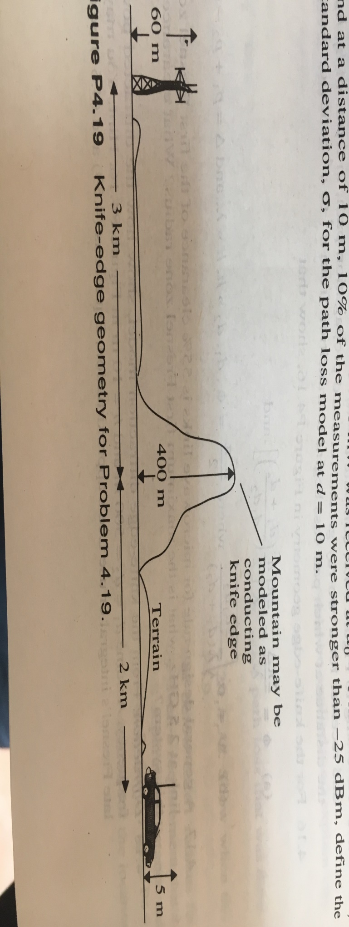
Exercise [Extra credit to first three students]
If Pt=10W, Gt=10dB, Gr=3dB and L=1dB at 900MHz. Compute the receiver power for the knife edge geometry shown in figure (Knife edge obstruction). Compute this value with a theoretical free space received power if the obstruction did not exist. What is the path loss due to diffraction for this case?

Slide 27
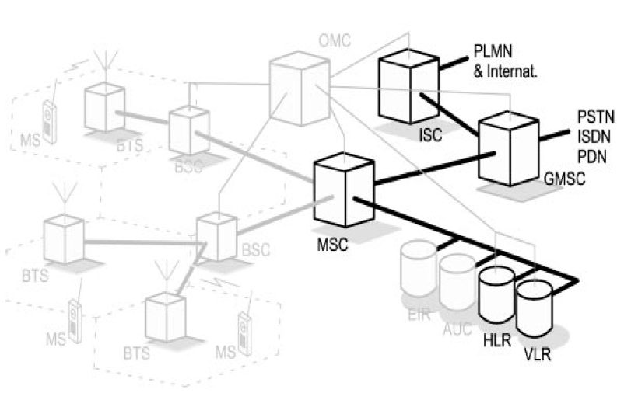
Service Provider Architecture

Slide 28
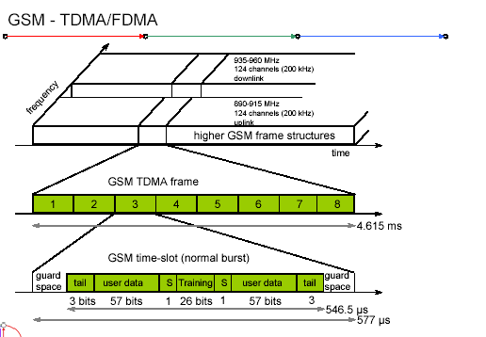
Traffic channels (another representation)
Notes:
This training sequence is used as a timing reference and for equalization. There is a total of eight different bit sequences that may be used, each 26 bits long. The same sequence is used in each GSM slot, but nearby base stations using the same radio frequency channels will use different ones, and this enables the mobile to differentiate between the various cells using the same frequency.
Muti-path equalization is used to extract the desired signal from unwanted reflections.

Slide 29
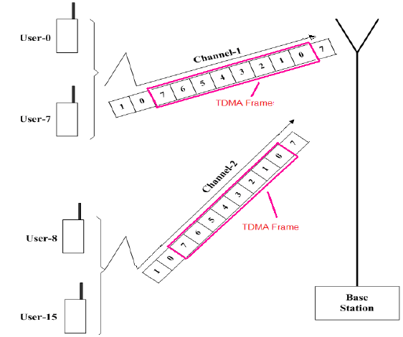
Traffic channels (another representation)
Notes:
These tail bits at the start of the GSM burst give time for the transmitter to ramp up its power and vice versa

